Slide 1
Advanced Object–Oriented Design & Programming (AOODP) Seminar – 2: Unit 2 SOLID Principles of OO Design
Dr. Anupam Mazumdar
Email: anupam.mazumdar@kaplan.com
anupam.mazumdar@aspectworld.com
21/10/2025

Slide 2
Outlines of the Seminar -2
Introduction to SOLID Principles:
- Overview of OO design
- Importance of SOLID principles in software development
Detailed exploration of SOLID Principles:
- Single Responsibility Principle (SRP)
- Open/Closed Principle (OCP)
- Liskov Substitution Principle (LSP)
- Interface Segregation Principle (ISP)
- Dependency Inversion Principle (DIP)
Practical Exercises & Answers
References

Slide 3
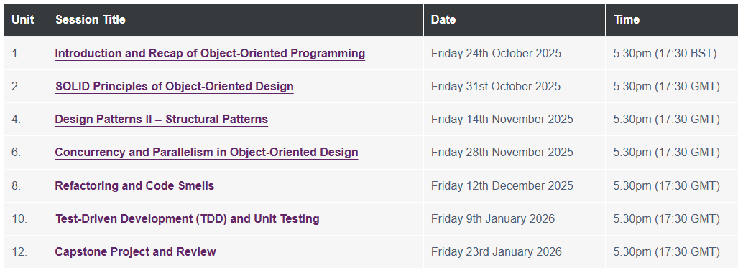
The organisation of the Seminars!

Slide 4
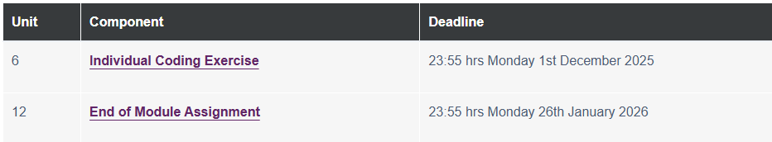
Deadlines of Assignment Submission

Slide 5
Introduction to SOLID Principles
The SOLID principles are a set of five design principles in Object-Oriented Programming (OOP) that help create maintainable, scalable, and flexible software.
SOLID principles improves code readability and maintainability
SOLID principles reduces tight coupling and fragility
SOLID principles encourages reusable and modular design
SOLID principles is a set of five design principles aimed at reducing code rigidity, fragility, and increasing reusability and maintainability

Slide 6
Importance of SOLID Principles in OO Design
Some key importance of SOLID principles are below:
Enhances maintainability
Reduces Code Duplication & Improves Reusability
Minimizes Tight Coupling
Improves Scalability
Facilitates Easier Testing (Better Testability)
Encourages Better Collaboration in Teams
Reduces Risk of Bugs & Side Effects
Supports Agile & Long-Term Development

Slide 7
Why SOLID Principles in OO Design?
Here are the key reasons why SOLID principles are essential in OO design.
To avoid monolithic, Spaghetti Code
To enable easier maintenance & updates
To reduce rigid, fragile designs
To improve testability
To support scalability & future growth
To prevent violations of logical behavior
To streamline team collaboration
To minimize technical debt

Slide 8
Challenges of SOLID principles in OO Design
Below is a list of key difficulties developers face when applying SOLID in OO design:
Increased complexity & over-engineering
Steeper learning curve
Performance overheads
Overuse of Dependency Injection (DI)
Rigid adherence can limit pragmatism
Testing complexity
Interface proliferation (ISP Pitfalls)
LSP violation in real-world hierarchies
Upfront time investment
Misapplication in Non-OO context

Slide 9
SOLID Principle – Single Responsibility Principle (SRP)
Example 1: Violation
class User:
def __init__(self, name: str):
self.name = name
def save_to_database(self):
print(f"Saving {self.name} to database...")
Problem: `User` handles both data representation AND database operations.
A class should have only one reason to change (i.e., one job)
Each class/module should encapsulate a single responsibility
Avoid “Good classes” that do too much

Slide 10
SOLID Principle – Open/Closed Principle (OCP)
Software should be open for extension but closed for modification
Add new features via inheritance/composition, not by changing existing code
Use abstraction (interfaces) to enable flexibility
Example: Violation
class Discount:
def apply(self, price, user_type):
if user_type == "VIP":
return price * 0.8
elif user_type == "Regular":
return price * 0.9
# Adding a new type requires modifying this method!
Problem: Must edit `apply()` for every new user type.

Slide 11
SOLID Principle – Liskov Substitution Principle (LSP)
Subclasses should substitute their parent class without breaking behavior
Child classes must not weaken preconditions or strengthen postconditions
Avoid surprises when replacing a parent with a child
Example: Violation (Square-Rectangle Problem)
class Rectangle:
def __init__(self, width, height):
self.width = width
self.height = height
def area(self):
return self.width * self.height
class Square(Rectangle):
def __init__(self, side):
super().__init__(side, side)
Problem: Setting `square.width = 5` breaks the square's invariant (width != height).

Slide 12
SOLID Principle – Interface Segregation Principle (ISP)
Clients should not depend on interfaces they do not use
Prefer small, focused interfaces over monolithic ones
Avoid forcing classes to implement irrelevant methods
Example: Violation
class Machine:
def print(self):
pass
def scan(self):
pass
def fax(self):
pass
Problem: A simple Printer must implement unused `scan()` and `fax()`.

Slide 13
SOLID Principle – Dependency Inversion Principle (DIP)
High-level modules should not depend on low-level modules. Both should depend on abstractions
Depend on interfaces, not concrete implementations
Enables loose coupling and easier testing.
Example: Violation
class LightBulb:
def turn_on(self):
print("Bulb: ON")
class Switch:
def __init__(self):
self.bulb = LightBulb()
def operate(self):
self.bulb.turn_on()
Problem: Switch is tightly coupled to LightBulb.

Slide 14
Seminar Task
Write simple code snippets and practice refactoring them to improve readability and maintainability

Slide 15
Reference!
Marcotte, C.-H. (2022) An atypical asp.net core 6 design patterns guide : a solid adventure into architectural principles and design patterns using .net 6 and c# 10. Second edition. Birmingham, England ; Packt Publishing. https://essex.primo.exlibrisgroup.com/permalink/44UOES_INST/ngp9lg/alma991008470538107346
Martin, R. C. (2023) Functional Design: Principles, Patterns, and Practices. Addison-Wesley Professional. https://essex.primo.exlibrisgroup.com/permalink/44UOES_INST/1h1udbn/cdi_askewsholts_vlebooks_9780138176471
Ayeva, K. & Kasampalis, S. (2024) Mastering Python Design Patterns: Craft Essential Python Patterns by Following Core Design Principles. 3rd edition. Birmingham: Packt Publishing, Limited. https://essex.primo.exlibrisgroup.com/permalink/44UOES_INST/1h1udbn/cdi_proquest_ebookcentral_EBC31355094
Sarcar, V. (2022) Java Design Patterns: A Hands-On Experience with Real-World Examples. Third edition. [Online]. Berkeley, CA: Apress. https://essex.primo.exlibrisgroup.com/permalink/44UOES_INST/1h1udbn/cdi_perlego_books_4513941
Yanakiev, I. et al. (2025) Applying SOLID principles for the refactoring of legacy code: An experience report. The Journal of systems and software. [Online] 220112254-. https://essex.primo.exlibrisgroup.com/permalink/44UOES_INST/1h1udbn/cdi_elsevier_sciencedirect_doi_10_1016_j_jss_2024_112254

